Slide 1
Exploration on non-adversarial perturbation in NLP methods
Lingfeng Shen
Tencent

Slide 2
Background
Empirical Study/Evaluation
Application
Understanding/Explanation
Miscellaneous

Slide 3
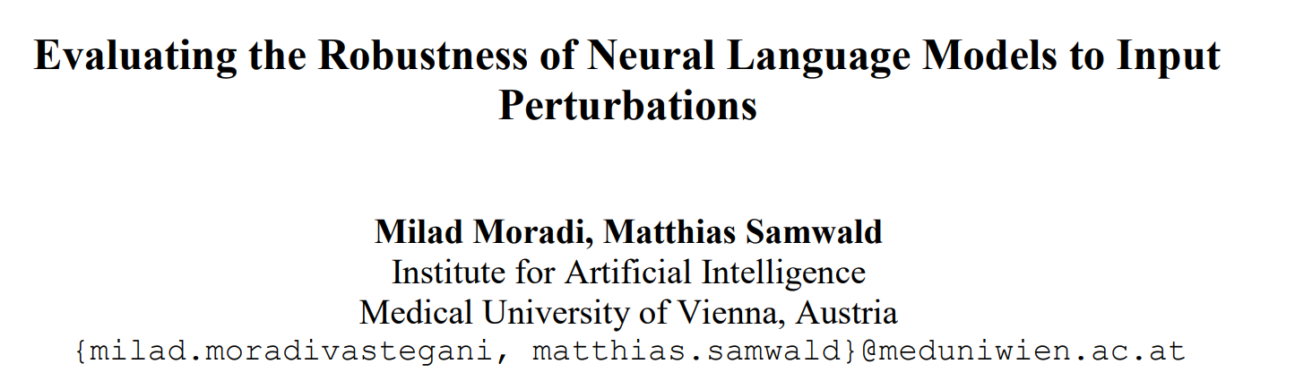
Background

Slide 4
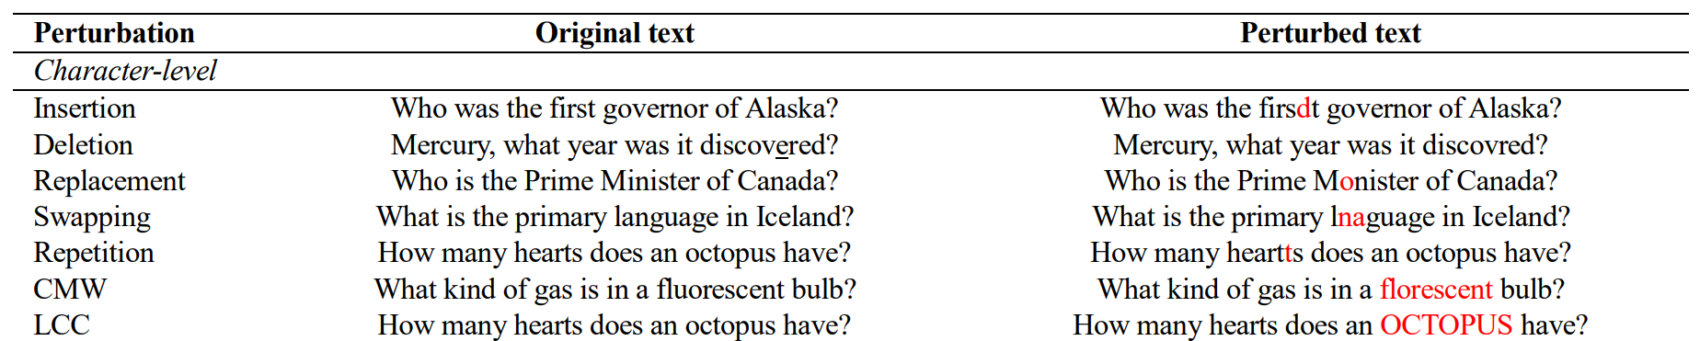
Tasks: Text classification, QA, NER, Sentiment analysis, STS
Models: BERT, RoBERTa, ELMo and XLNet
Perturbation methods:
character-level:
This paper designs and implements a wide range of character-level and word-level systematic perturbations to textual inputs in order to simulate different types of noise that a NLP system may face in real-world use cases

Slide 5
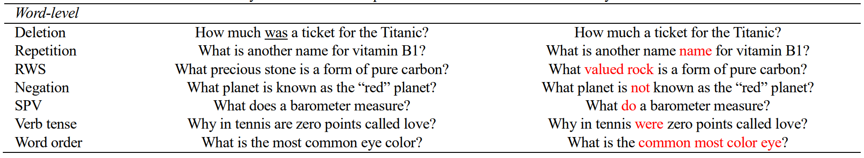
Word-level perturbation

Slide 6
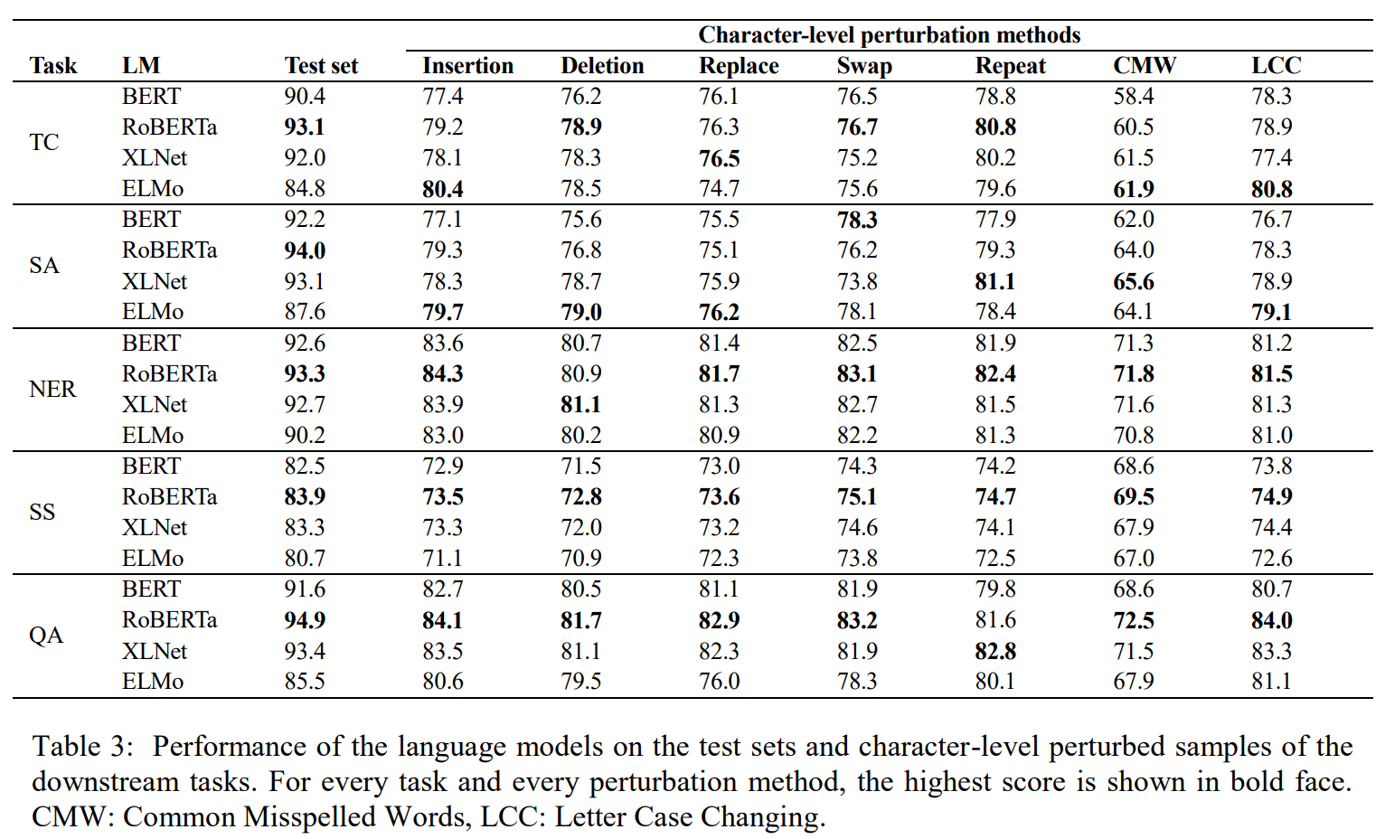

Slide 7
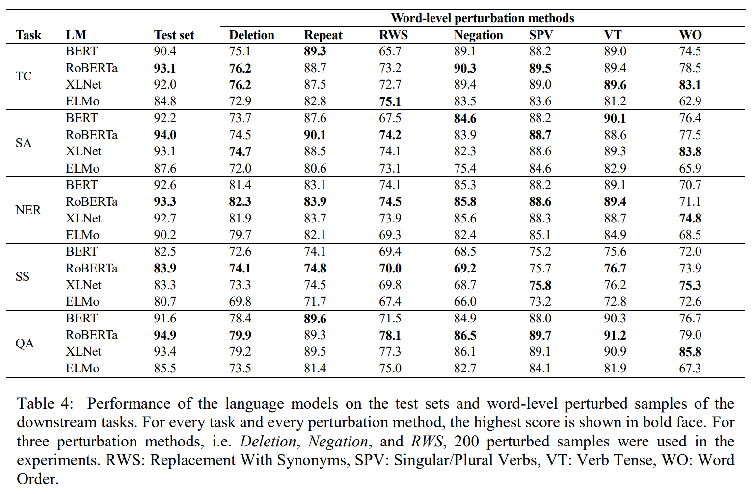

Slide 8
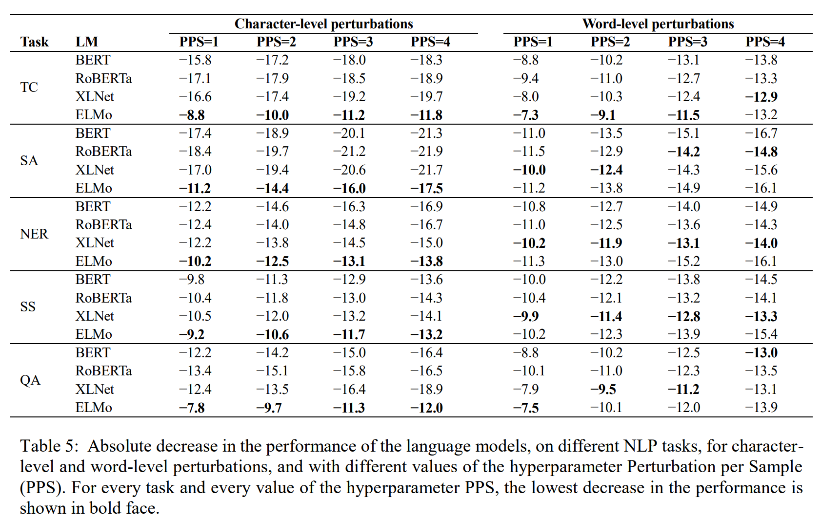

Slide 9
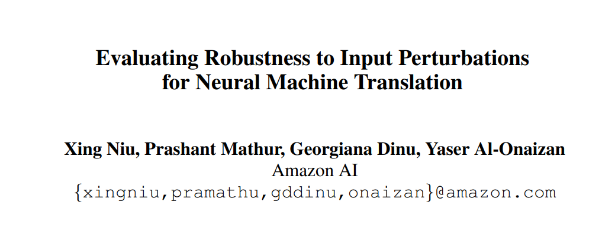
Empirical study/evaluation

Slide 10
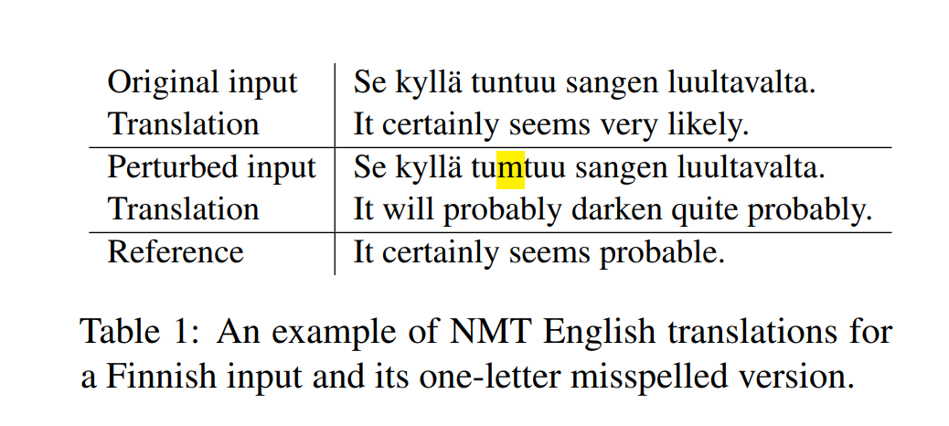
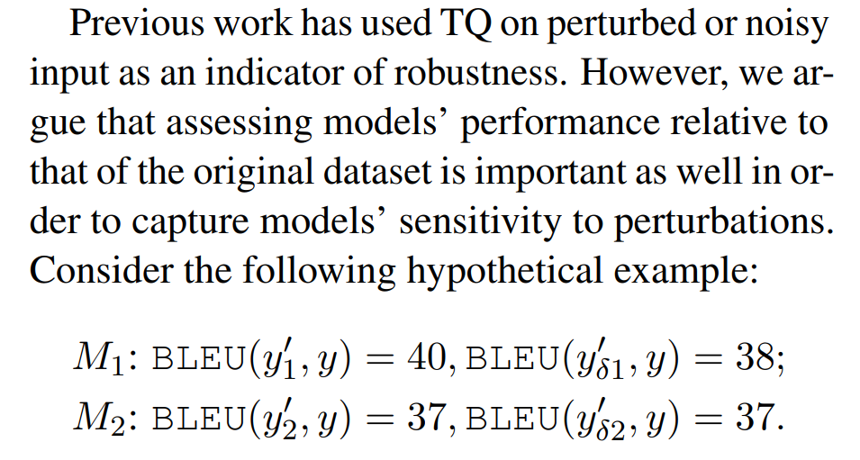
Previous work has used translation quality measures such as BLEU on noisy input as an indicator of robustness. Absolute model performance on noisy input is important, and we believe this is an appropriate measure for noisy domain evaluation. However, it does not disentangle model quality from the relative degradation under added noise.

Slide 11
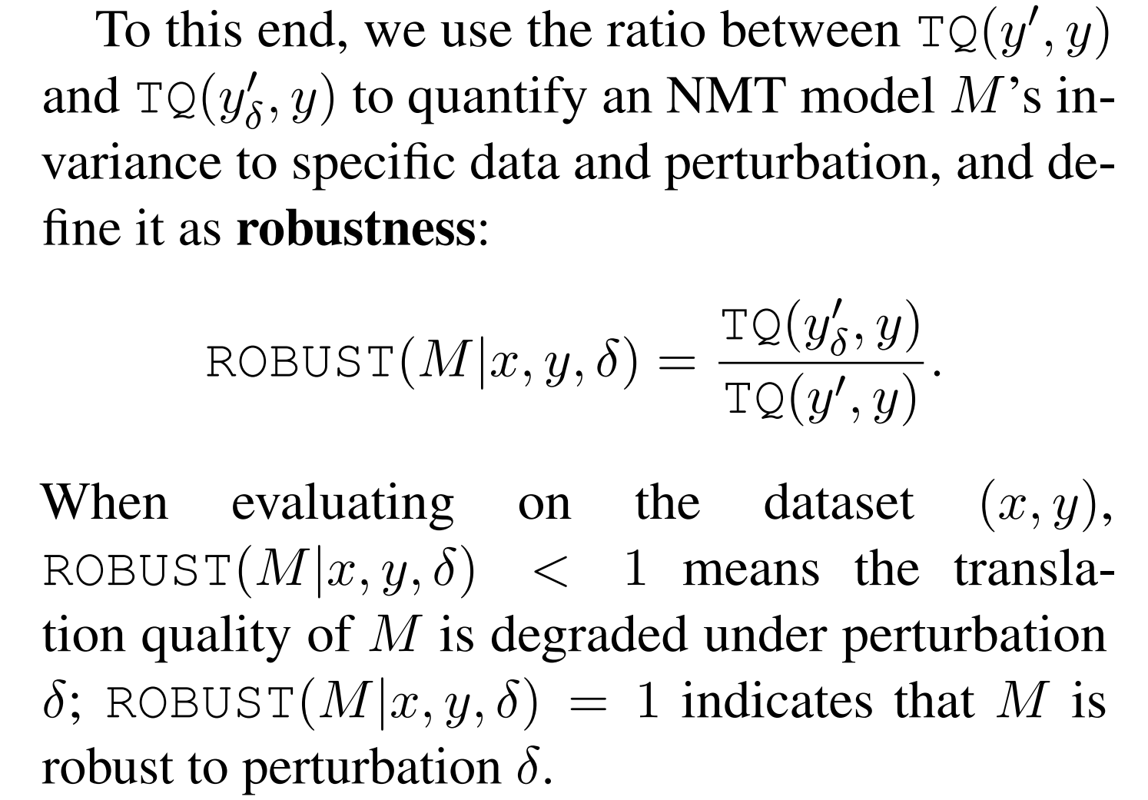
Formulation

Slide 12
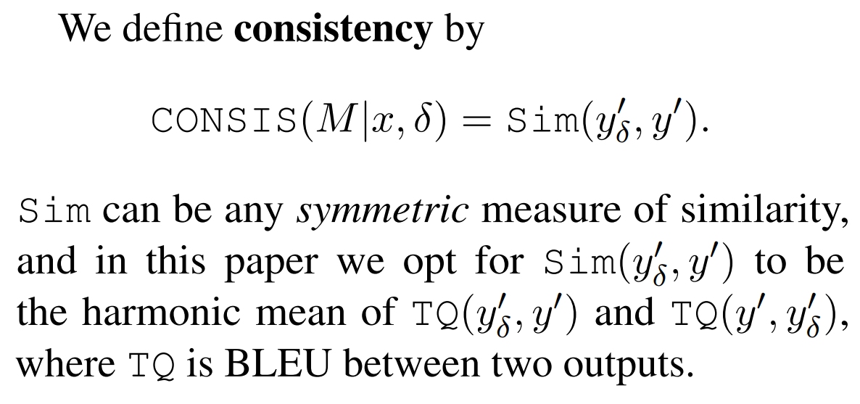

Slide 13
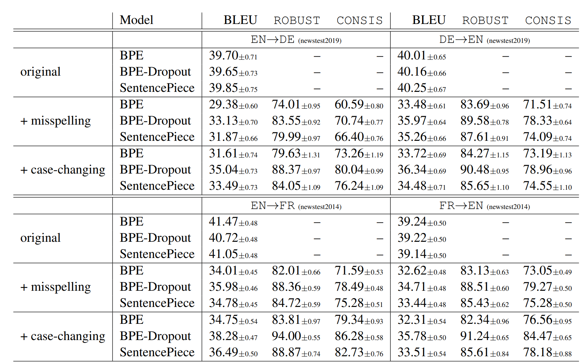

Slide 14
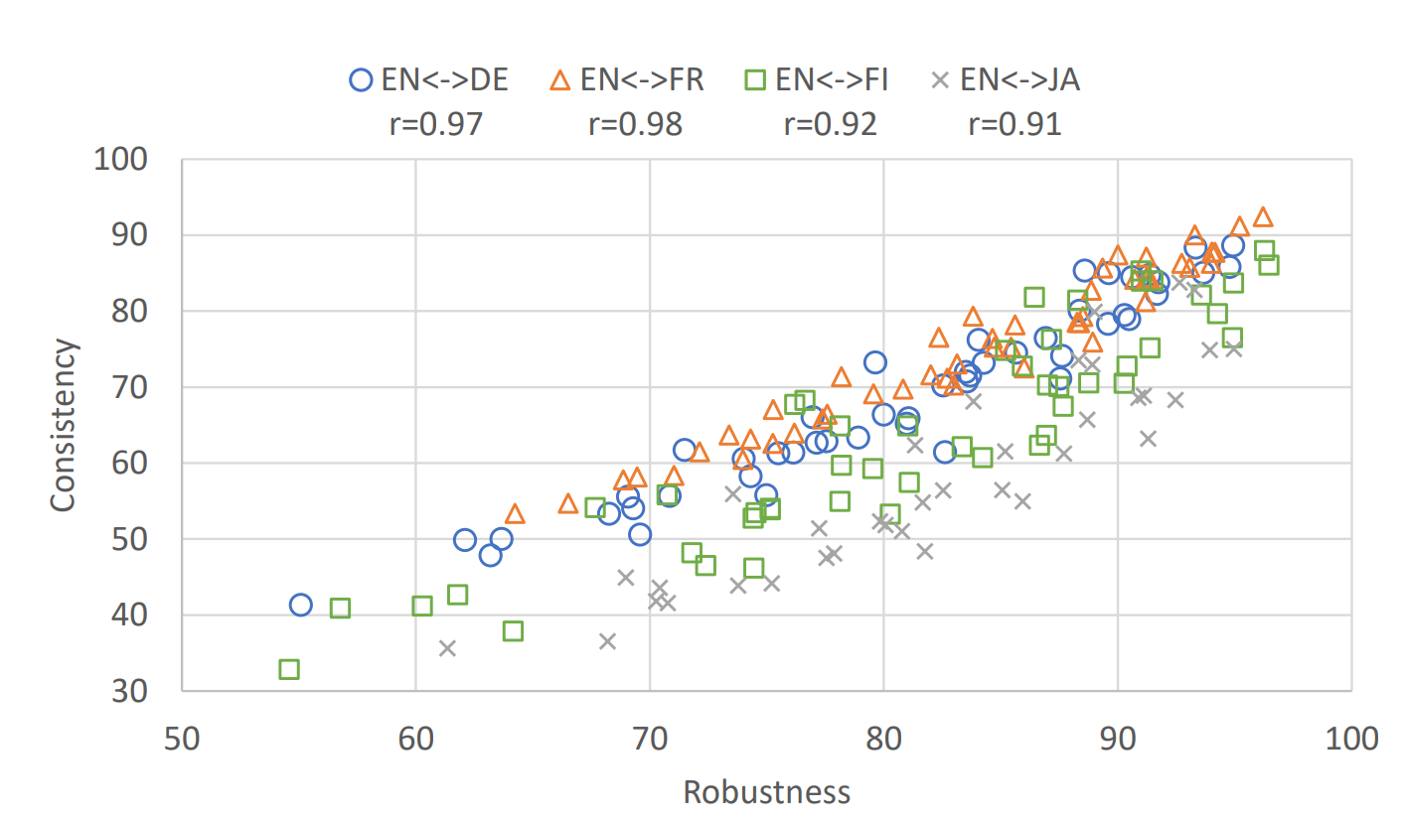

Slide 15
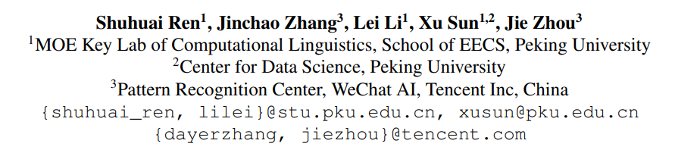
Text Auto-Augment: Learning Compositional Augmentation Policy for Text Classification
Application

Slide 16
Generation-based methods utilize conditional generation models to synthesize the paraphrases of the original sentences，which have advantages in instance fluency and label preservation but suffer from the heavy cost of model pre-training and decoding.
Editing-based methods instead apply label-invariant sentence editing operations (swap, delete, etc.) on the raw instance, which are simpler and more efficient in practice. However, the editing-based methods are sensitive to the preset hyper-parameters including the type of the applied operations and the proportion of words to be edited.
To overcome the limitations above, this paper propose a framework named Text Auto-Augment (TAA) to establish a learnable and compositional paradigm for the data augmentation. Our goal is to automatically learn the optimal editing-based data augmentation policy for obtaining a higher quality augmented dataset and thus enhancing the target text classification model.

Slide 17
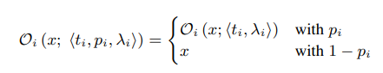
Compositional Augmentation Policy
We design an augmentation policy as a set of various editing operations: policy = {op1 , · · · , opN } and each operation is defined with a parameter triplet: op = <type t, probability p, magnitude λ>.
(1) Type t ∈ {Random Swap, Random Delete, TF-IDF Insert, TF-IDF Substitute, WordNet Substitute}.
(2) Probability p ∈ [0, 1] of being applied.
(3) Magnitude λ ∈ [0, 0.5] which determines the proportion of the words to be edited.

Slide 18
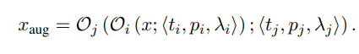
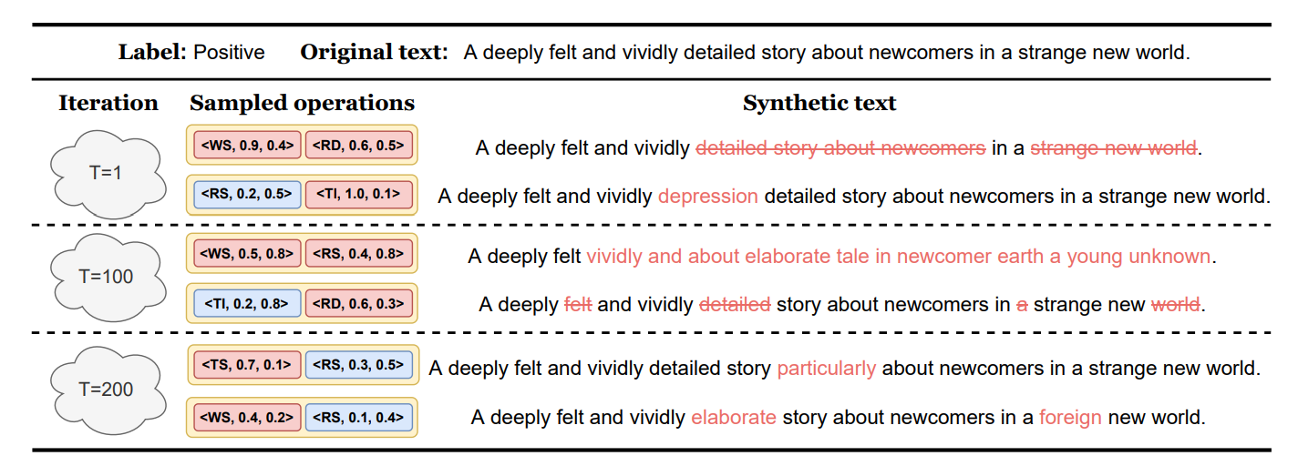
To further increase the diversity of augmented data and enlarge the support of the training distribution, our policy applies more than one operation to the original sentence in a recursive way

Slide 19
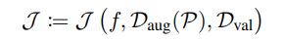
Learnable Data Augmentation Policy
In traditional methods, the parameters of data augmentation are preset before training then tuned on the validation set Dval, which is similar to the paradigm of hyper-parameters tuning.
For this reason, we cast the problem of augmentation policy optimization as the Combined Algorithm Selection and Hyper-parameter (CASH) optimization problem
We propose a novel metric to measure the loss of a policy and a model:
It denotes the loss that the model achieves on the validation set after trained on the augmented set.

Slide 20
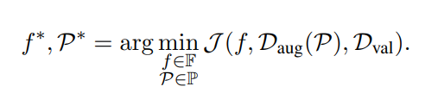
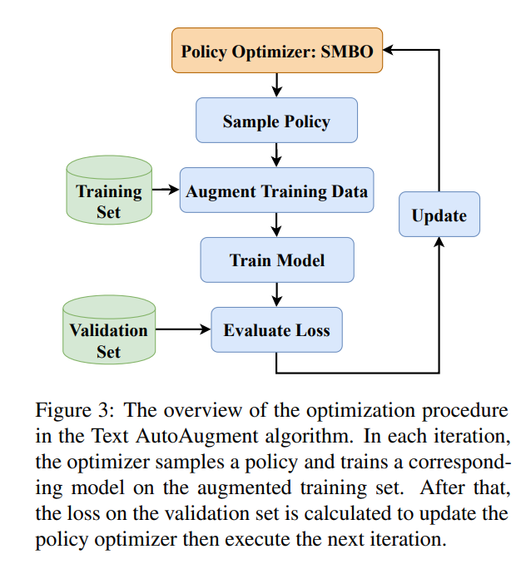
the objective function of our policy optimization can be written as follows:
Sequential Model-based Global Optimization (SMBO), a kind of Bayesian optimizer widely used in AutoML, to our TAA framework.

Slide 21
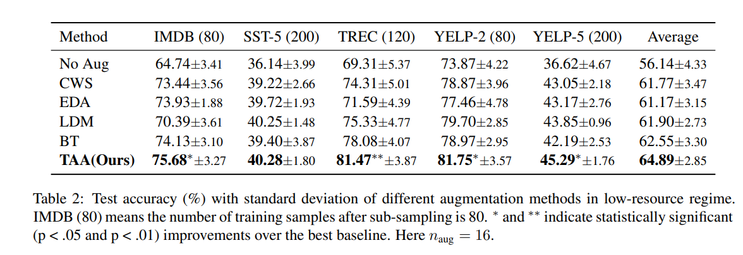

Slide 22
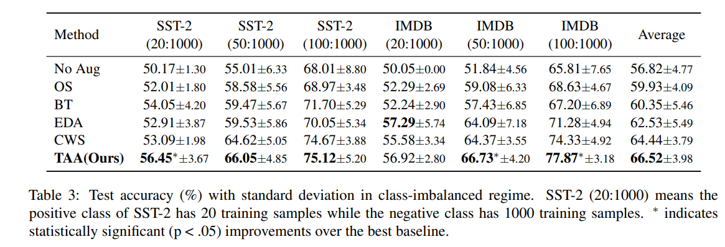

Slide 23
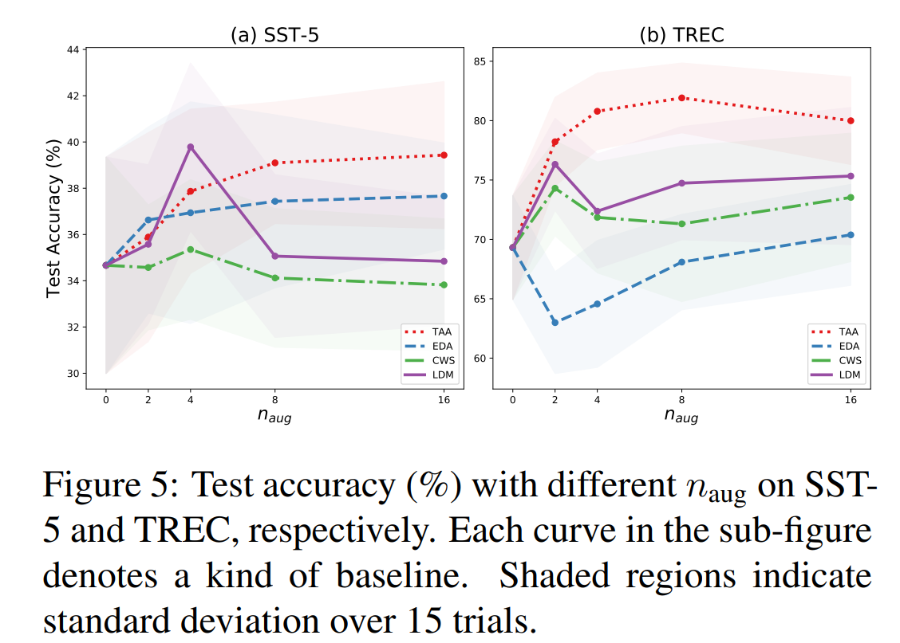
Impact of Augment Magnification

Slide 24
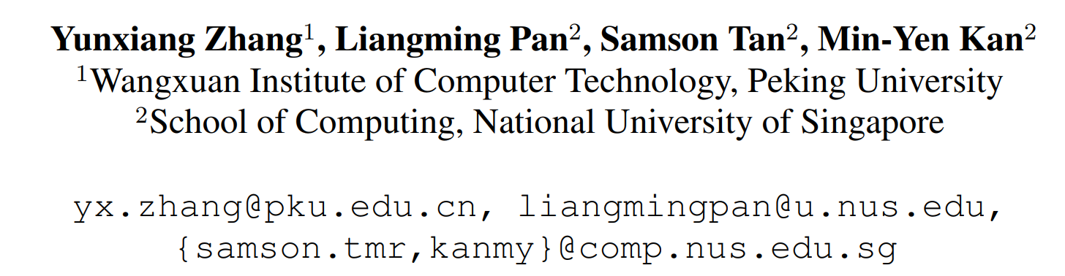
Explanation
Interpreting the Robustness of Neural NLP Models to Textual Perturbations

Slide 25
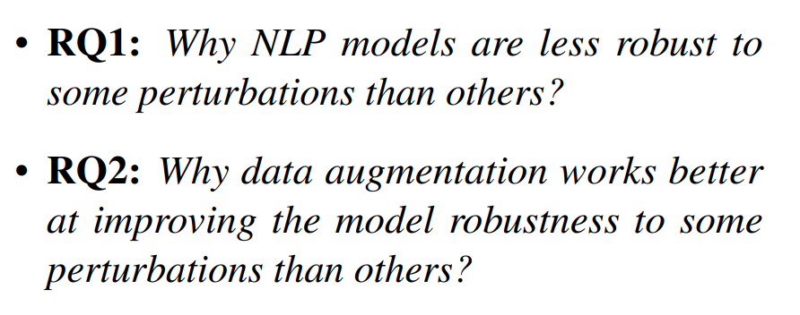

Slide 26
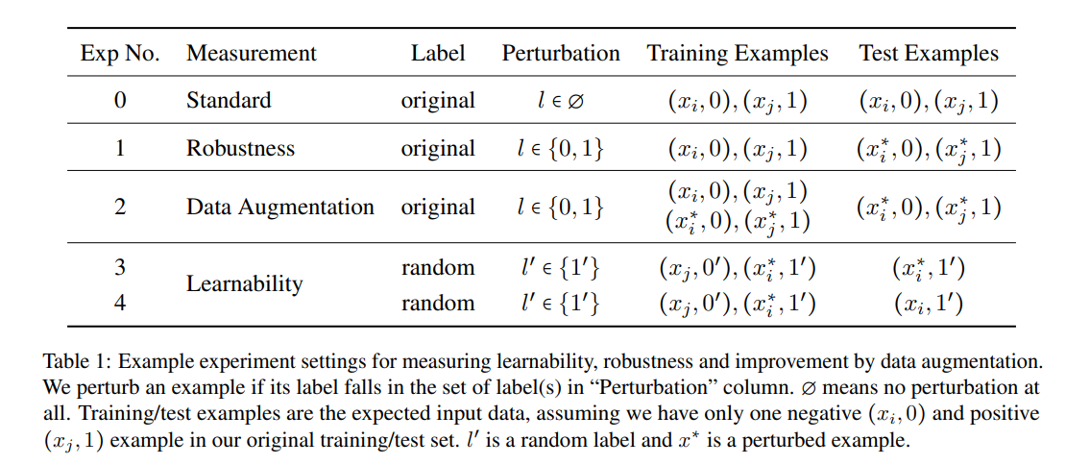
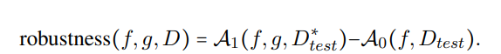
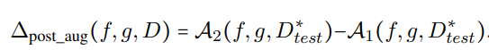
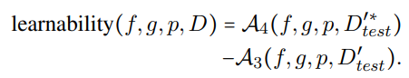

Slide 27
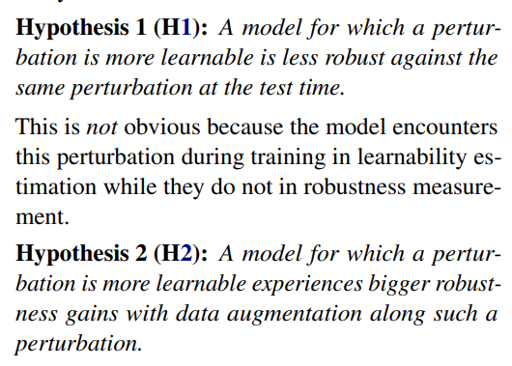

Slide 28
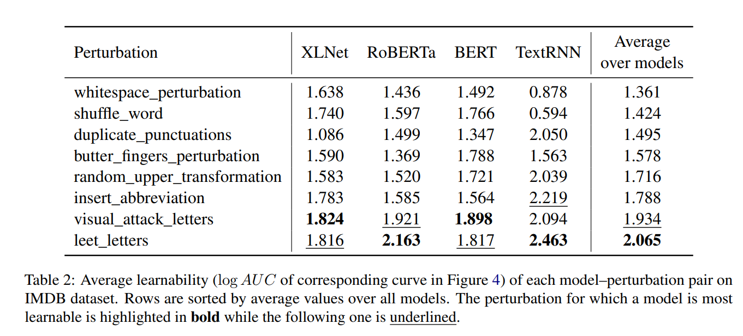

Slide 29
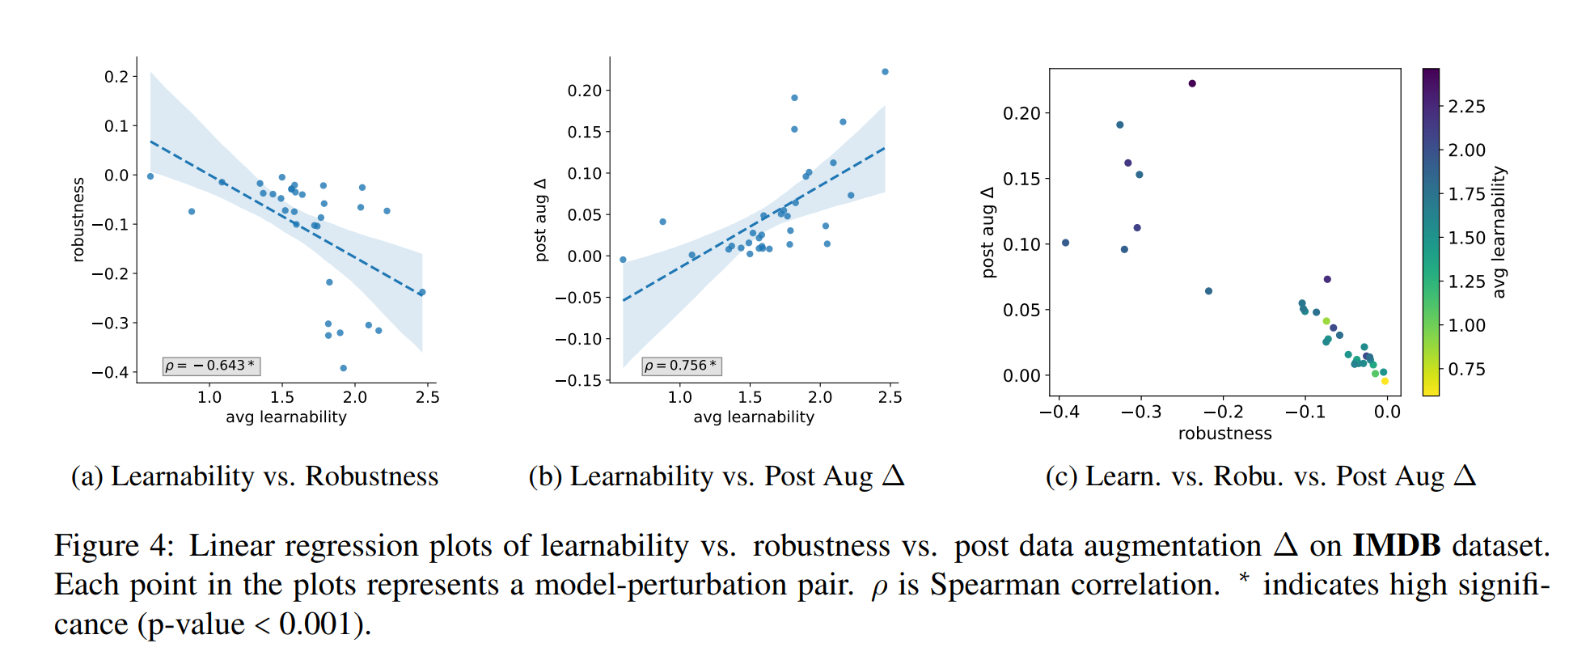
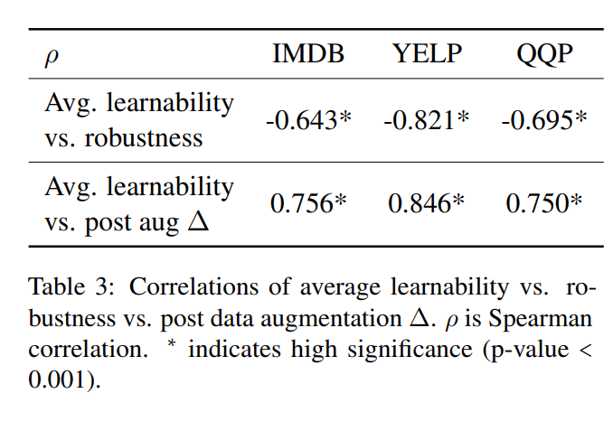

Slide 30
Conclusion
There is a negative correlation between learnability and robustness.
Data augmentation with a perturbation the model is less robust to has more improvement on robustness

Slide 31
Miscellaneous
Learning from Perturbations: Diverse and Informative Dialogue Generation with Inverse Adversarial Training (ACL 2021)
TabPert : An Effective Platform for Tabular Perturbation (EMNLP 2021)
RAP: Robustness-Aware Perturbations for Defending against Backdoor Attacks on NLP Models (EMNLP 2021)
Rethinking Perturbations in Encoder-Decoders for Fast Training (NAACL 2021)
Double Perturbation: On the Robustness of Robustness and Counterfactual Bias Evaluation (NAACL 2021)
Perturbation CheckLists for Evaluating NLG Evaluation Metrics (EMNLP 2021)
Non-adversarial perturbation VS adversarial perturbation

